Slide 1
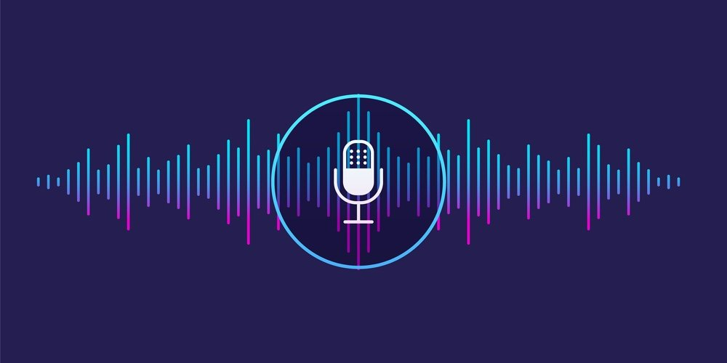
Desktop Voice Assistant

Slide 2
Basic Idea
The Idea behind the project is to make a voice assistant that is capable of doing basic tasks like :
It can send emails.
It can play music .
It can do Wikipedia searches.
It is capable of opening websites like Google, Youtube, etc., in a web browser.
It is capable of opening your code editor or IDE with a single voice command.

Slide 3
Working
It works with the help of Python Functions and Modules like :
speak() : This function will take audio as an argument, and then, it will pronounce it.
wishme() : This function will help to wish or greet the user according to the time of computer or pc.
we need to import a module called datetime.
takeCommand() : A.I. assistant will be able to return a string output by taking microphone input from the user.
we need to install a module called speechRecognition
sendEmail() function, which will help us to send emails to one or more than one recipients.

Slide 4
More API's And Libraries
pyttsx3
A python library which helps to convert text to speech.
sapi5
It is a Speech API developed by Microsoft. Helps in synthesis and recognition of voice.
VoiceId
Voice id helps us to select different voices.
voice[0].id = Male voice
voice[1].id = Female voice

Slide 5


